Slide 1
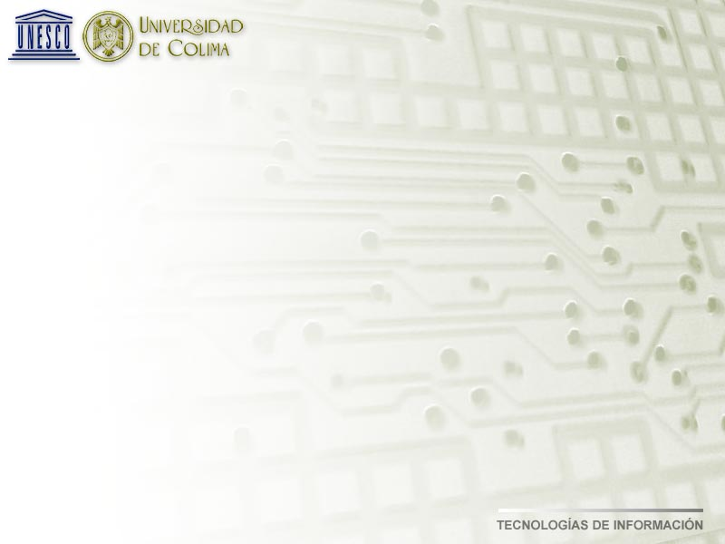
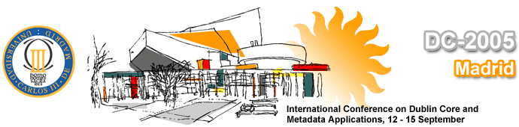
Model of Metadata (Crosswalk)
on the Iberoamerican and Caribbean Virtual Library
Javier Solorio Lagunas Lourdes Feria Basurto
CGSTI, Proyectos Especiales CGSTI
Universidad de Colima Universidad de Colima
solorioj@ucol.mx lferia@ucol.mx

Slide 2
Antecedentes
The Iberoamerican and Caribbean Digital Library initiative was launched 1998.
Financial support was given by Consejo Superior de Informática of Spani to UNESCO.
UNESCO invited a group of international experts to analyze and define a model for the digital library
- Instituto Brasileño de Información Científica (IBICT)
- Centro Regional de Información en Ciencias Médicas (BIREME), Brasil
- Centro Nacional de Ciencias Médicas de Cuba (INFOMED)
- Instituto Tecnológico de Estudios Avanzados de Monterrey, México
- Universidad de Colima, México

Slide 3




Antecedents
The experts group suggested a model based on open software for Linux and Windows.
Apache web server- Data base manager
MySQL
- Z39.50 Protocol – Programming language

Slide 4
Antecedents
A methodology for its implementation in any kind of library in the region; National, University, Public, Research libraries
Methodology
Manual for info resources register (Metadata)
Resources digitization (Texts, images, video, etc…)
Software installation

Slide 5
Methodology
Today in this conference we will just talk about the methodology for the metadata model and for information access and exchange based on Z3950 Protocol.
Cross references, relations between:
GILS
MARC21
Dublin Core

Slide 6
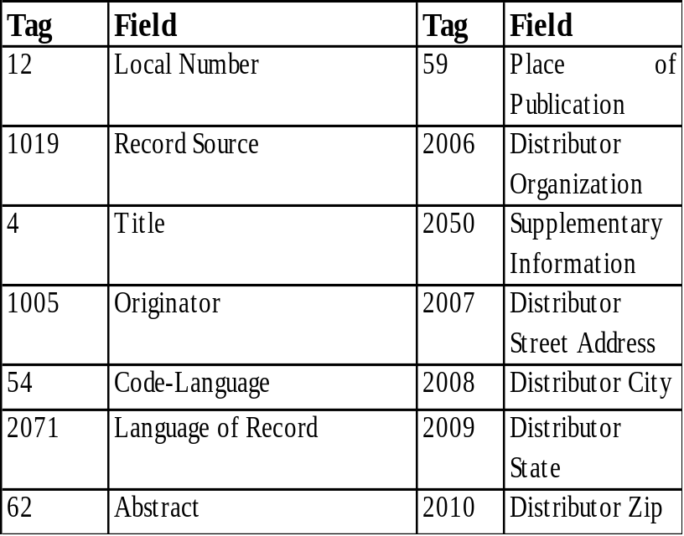
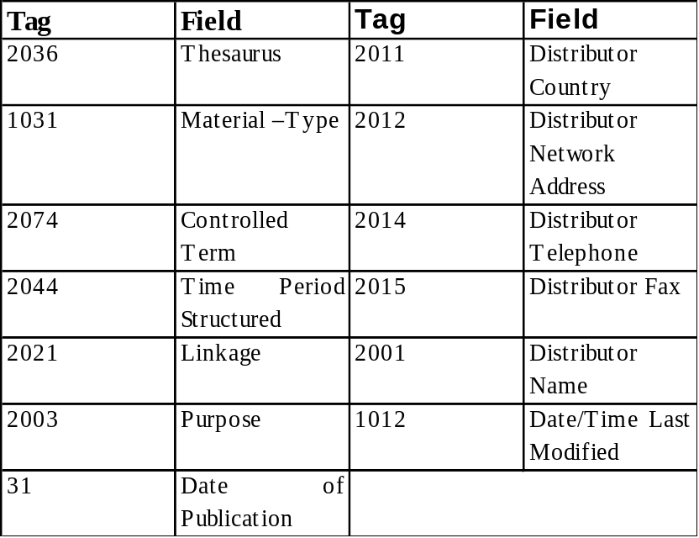
Metadata Model
GILS (Government Information Locator Services)
The base of the metadata standard in the BVIC is the GILS system, which, as has been mentioned, is part of the information locator of the BVS, from it we took 27 fields or elements for its cross relation and correspondence with MARC21 and those which correspond with Dublin Core.

Slide 7
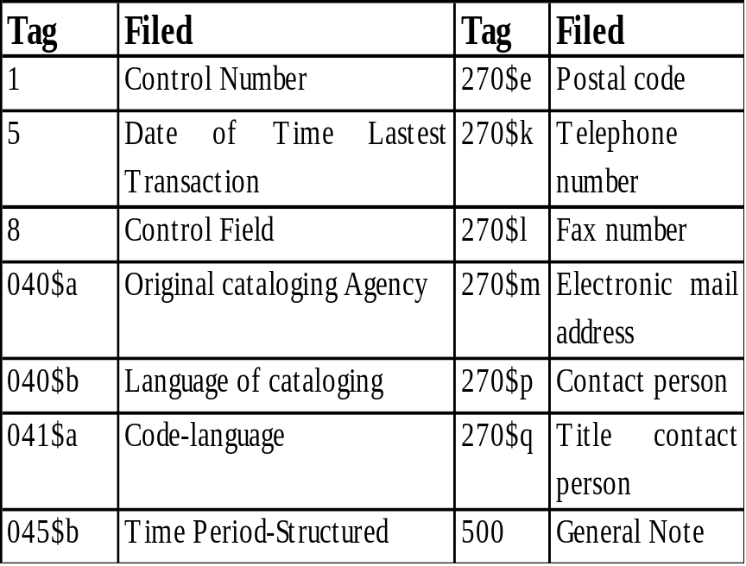
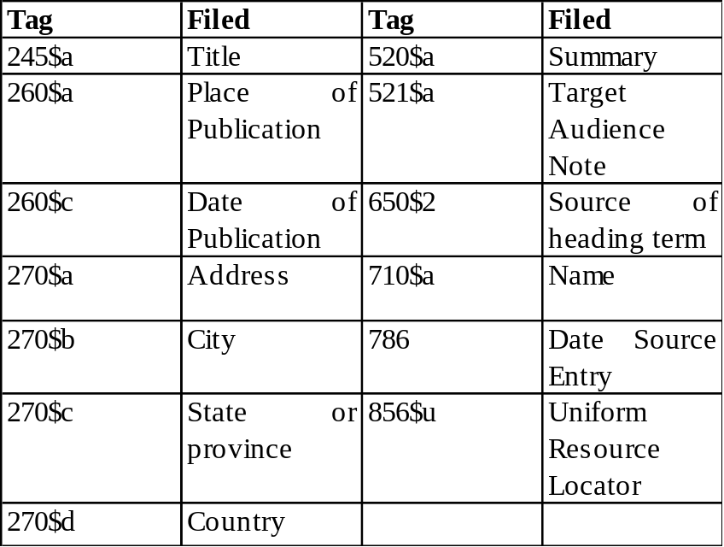
Modelo de metadatos
MARC21
In the case of MARC21 we used 27 elements or fields and subfields for the relations primarily with the GILS standard. The following board shows the name of the field with its correspondent tag.

Slide 8
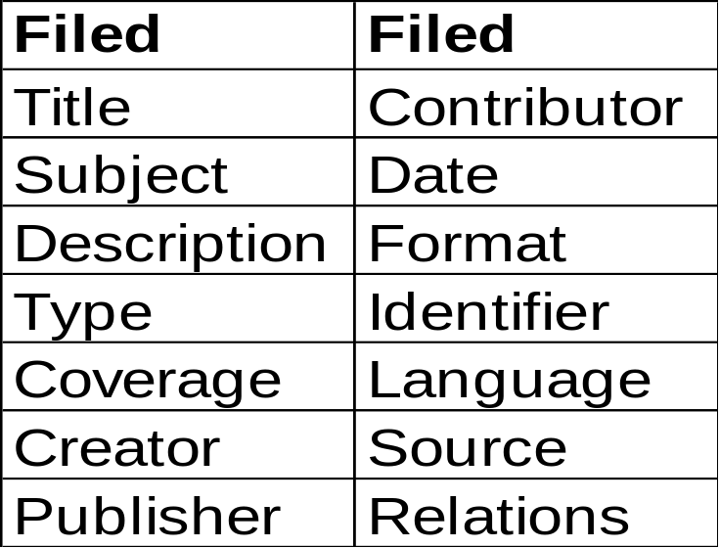
Metadata Model
Dublin Core
We use 14 Dublin Core Standard’s tags, it does not include Copyrigth tag, due to the fact that the library’s goal is to promote publication of copy-left contents.

Slide 9
Crosswalk relations of metadata elements between the three standards
In the Dublín Core case, in some elements we have used the DCQ (Dublin Core Qualifiers), as an example: in Description we used the relations with other standards in the field Abstract and Summary of GILS and MARC respectively. In the element Date we made the relations as well as in the date of publication as on the date of last modification. For the field Originator of GILS and Name of MARC we related the elements Creator, Publisher and Contributor of DC.
We have implemented in the interface of capture or metadata indexation in the field Thasurus, the consult of different languages controlled of free access on the Internet; Macrothesaurus of OECD, UNESCO’s Thesaurus, DecS

Slide 10
Crosswalk relations of metadata elements between the three standards
In our methodology it is descript in the Locator of Information Resources Guide the relations, cross references, between the elements or fields from the three standards, as well as a description of every field, its tags, etc.
Example
4.1.4 Originator
Field Description
GILS/Dublin Core Field: 1005
MARC21 Field: 710$a
Fixed length, 7 characters
Required
Repeatable
Field Definition
This element identifies the institution responsible for the creation of the information resource, or the organization(s) that assumes such responsibility.
If it contains the speeches of a public figure included in a database, the author will be the public figure, and the originator will be the entity responsible for creating the database.
Notes:

Slide 11
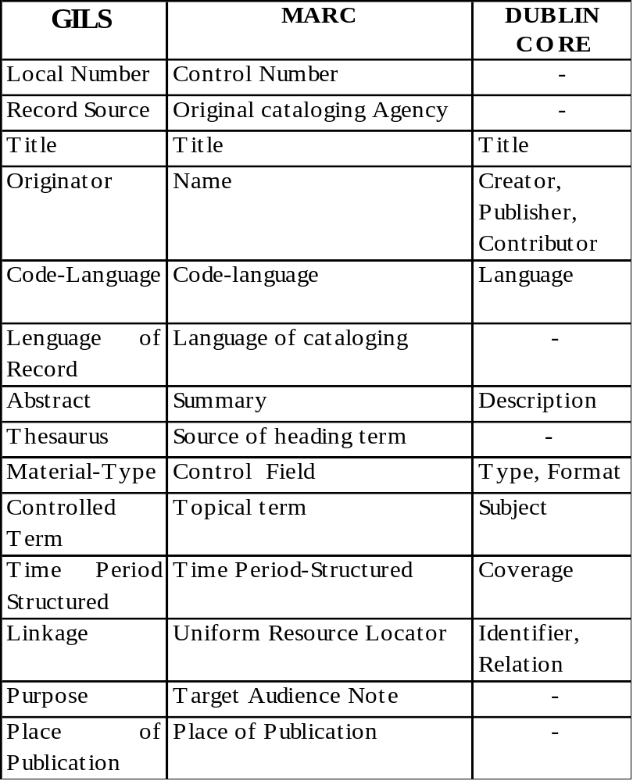
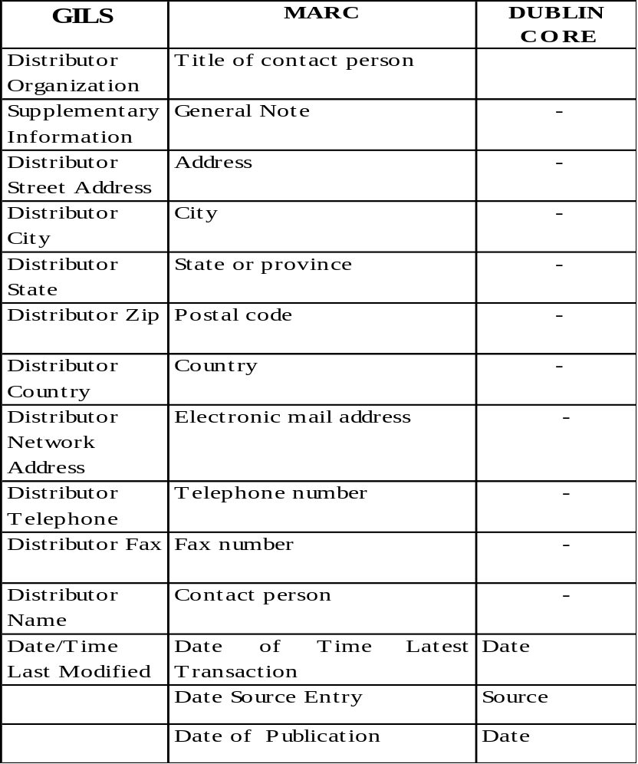
Crosswalk relations of metadata elements between the three standards

Slide 12

The metadata model is comprised of a data base in MySQL of 41 fields, structured in three boards, for the cataloguing, administration and retrieval of themselves. We will describe the boards according to the order in which they are used in the Virtual Library (BVIC).
Main board
Institutions board
-Local number
-Record source
-Title
-Originator
-Author
-Resource language
-Record language
-Resource type
-Abstract
-Thesaurus
-Subjects
-Temporal coverage
-Link
-Purpose
-Resource’s date of publication
-Register creation date
-Last modification date
-Place of publication
-Distributor
-Notes
-Institution code
-Institution name
-Institution type
-Physical address/street
-Physical address/city
-Physical address /state
-Physical address /postal code
-Country code
-Phone(s)
-Fax(es)
-Contact’s name
-E-mail for general communication
-Register creation date
Users board
-Name(s) y last names
-User’s name
-Password
-Institution code
-e-mail address
-Access level
-User’s creation date

Slide 13
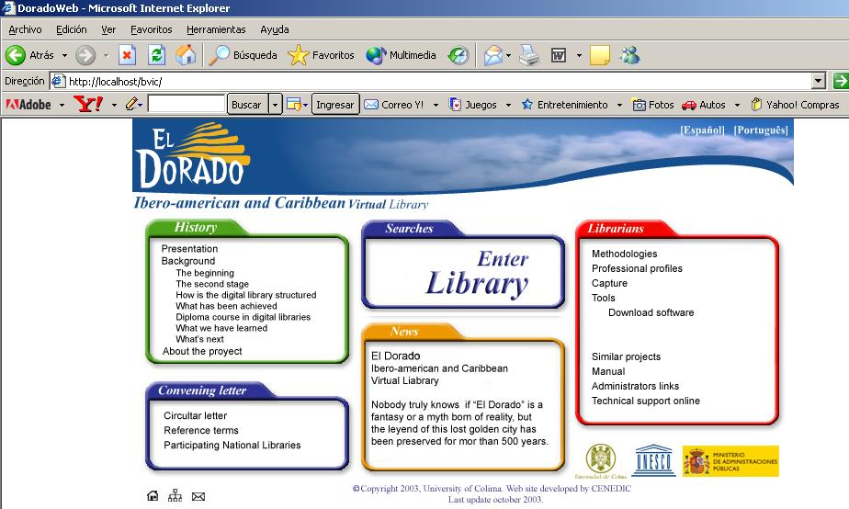
Web Site of the Library

Slide 14
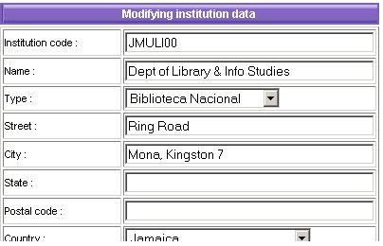
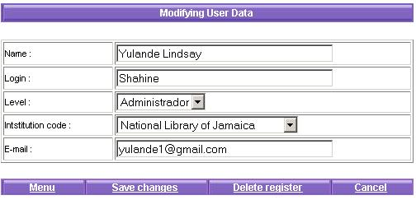
Metadata Entry Interfase
Inside the “bibliotecarios” (librarians) section there is an option for data entry to catalogue, correct, indization of metadata, as well as for the system management.
Institutions board Users board
Administrator
Approving
Librarian

Slide 15
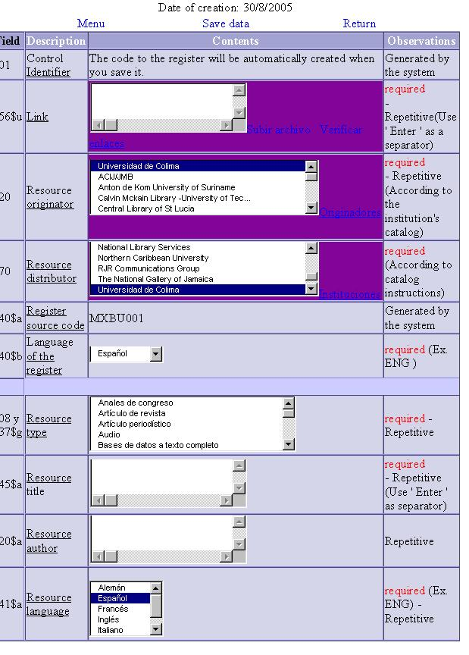
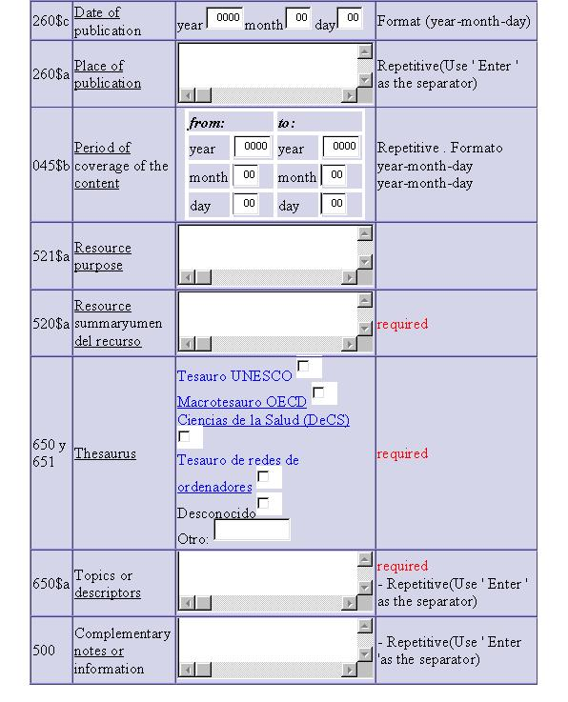
Metadata Entry Interfase
Main board

Slide 16
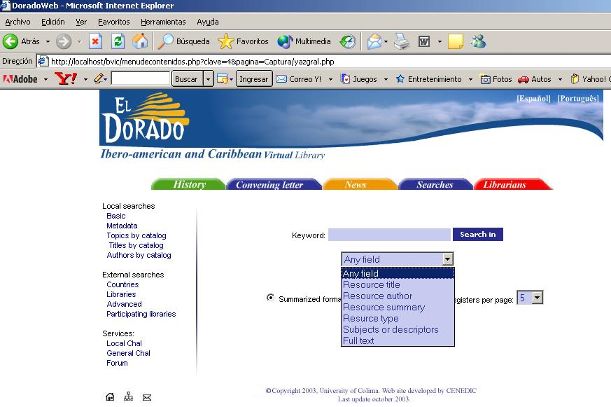
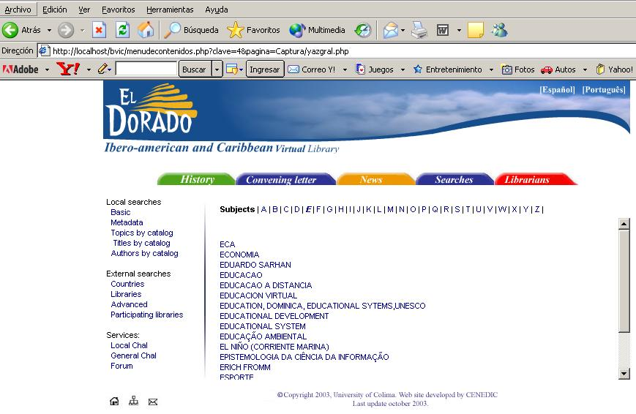
Search (Z39.50) Interfase
Through a searching interfase the users can find information by several options:
Local, basic, metadata, subject catalogue, titles, authors
External searchs, by countries, libraries, advanced search, access to servers, chat and forum.
Metadata
catalogue of subjects

Slide 17
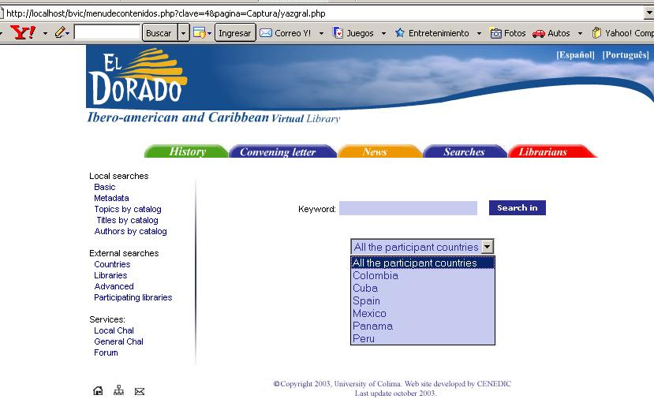
Search (Z39.50) Interfase
Search in other servers

Slide 18
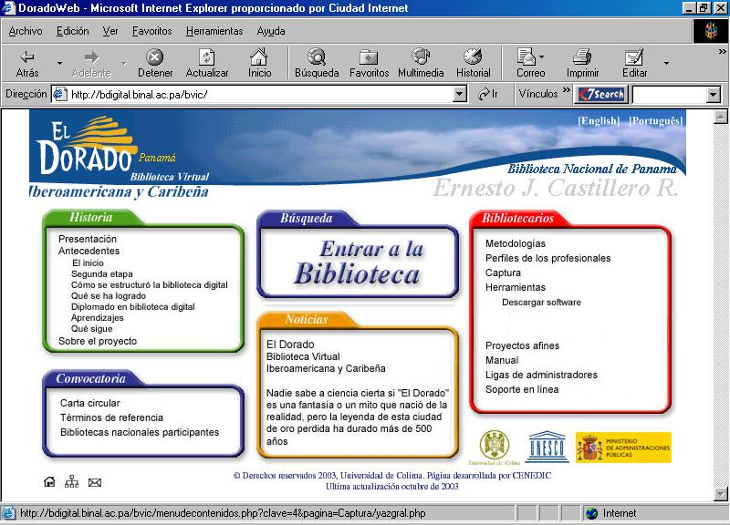
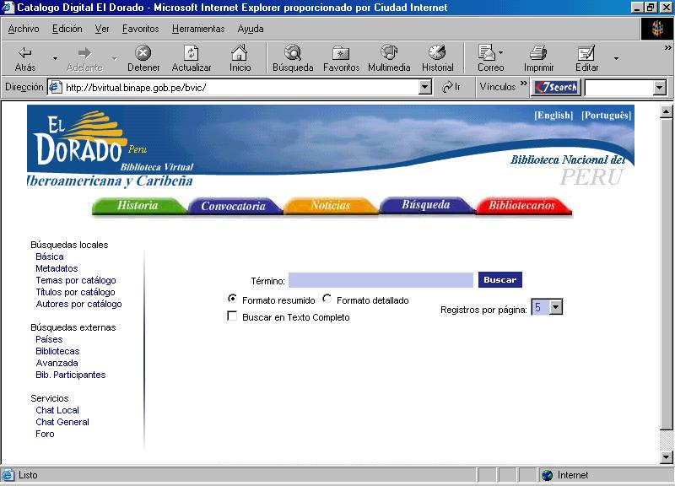
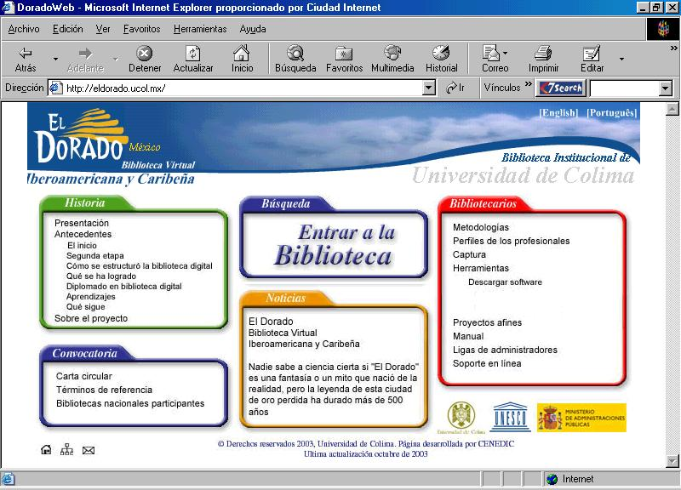
Current Installed Servers. Some Examples
Biblioteca Nacional de Panamá
Biblioteca Nacional de Perú
Universidad de Colima

Slide 19
Applications and new versions
Lucene Metadata Resources Indexer, instead of Z39.50
El Dorado Metadata model and cataloguing methodology
UNESCO’s Thesaurus taxonomy
Program or Web for document authomatic collection from Internet
servers
El Dorado Search interfase
User’s Forum and Chat
Biblioteca Virtual
El Dorado
BiblioDigital
Dr. Adolfo Arenas
Biblioteca Virtual del
Centro Cultural del
México Contemporaneo

Slide 20
Applications and new versions
Virtual Library New Versión in progress
Web Services
XML
Advantages over Z39.50, modern, easier
OAI-PMH Protocol (Dublin Core)

Slide 21
Thank you all
solorioj@ucol.mx

